Slide 1

HireGraph AI
Automating Recruitment with LangGraph & RAG
An intelligent terminal-based hiring assistant powered by a state graph architecture with human-in-the-loop confirmation — built for speed, consistency, and explainability.

Slide 2

The Problem with Manual Recruitment
🔁 Repetitive Reading
⚖️ Inconsistent Screening
Recruiters re-read the same job descriptions and resumes from scratch for every new query, with no reusable context.
Manual evaluation introduces subjective bias and inconsistency across candidates and hiring managers.
⏱️ Hours Lost to Research
Salary benchmarking and skill trend analysis consume hours per open role — time that should go to strategic hiring decisions.

Slide 3
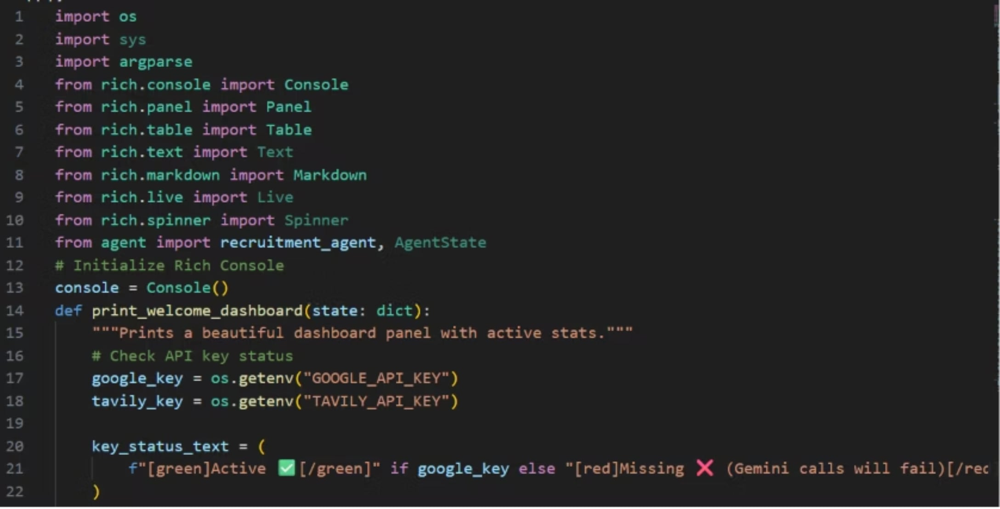
Solution Overview
A Conversational Hiring Agent
HireGraph AI is a conversational agent built as a LangGraph state machine. It operates entirely through a natural terminal chat interface and handles the full recruiter workflow:
Parses and structures job descriptions automatically
Screens resumes via Retrieval-Augmented Generation (RAG)
Automates shortlisting, comparison, and scheduling tasks
Keeps the recruiter in control at every critical step

Slide 4

System Architecture
Intent Router
LangGraph Nodes
ChromaDB & Gemini
Human Confirmation
Every user query is routed through an intent classifier that activates the appropriate LangGraph node. Nodes retrieve semantically relevant context from ChromaDB, generate responses via Gemini, and require explicit human sign-off before any consequential action is taken.

Slide 5

JD & Resume Intelligence
Structured JD Parsing
RAG Resume Screening
Job descriptions are parsed into typed Pydantic fields — role, skills, requirements — enabling downstream logic to operate on structured data.
ChromaDB powers semantic search across 15 candidate resumes, returning ranked match scores grounded in the JD.
Zero-LLM Fast Path
Recruiter Copilot
Simple counting queries like "how many applicants?" bypass the LLM entirely — instant answers, zero API cost.
Rewrites JDs by tone, auto-generates interview questions, compares candidates side-by-side, and flags JD-to-pool mismatches.

Slide 6

Live Web-Grounded Features
Salary Benchmarking
Skill Trend Analysis
Real-time salary data is retrieved via Tavily live web search — not from a static RAG index — ensuring benchmarks reflect current market conditions.
Emerging skill demands are surfaced through live queries. When no API key is present, an automatic local-cache fallback ensures the feature degrades gracefully rather than failing silently.

Slide 7
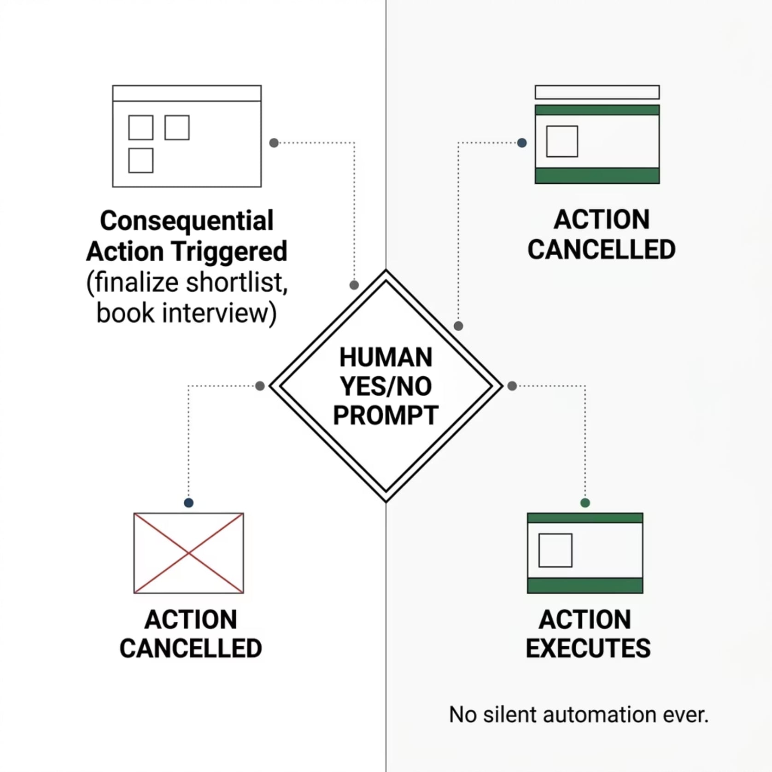

Human-in-the-Loop Safety
Explicit Confirmation Required
Every consequential action — finalizing a candidate shortlist or booking an interview slot — is gated behind an explicit yes/no prompt.
No action is ever executed silently or assumed. The recruiter remains the final authority at every decision point.
Trust is built through transparency. HireGraph AI is a copilot, not an autopilot.

Slide 8

Moonshot Features & Smart Caching
🚩 Red-Flag Detection
📋 Batch Screening Report
⚡ Resume Parsing Cache
Dependency-free analysis automatically surfaces employment gaps, experience mismatches, and qualification concerns — no additional LLM call required.
A single command generates a comprehensive screening report across all candidates in the pool, with match scores and flags compiled in one pass.
Pre-generated parsed resume data is cached to disk, eliminating redundant LLM calls across sessions — directly reducing API cost and response latency.

Slide 9
Tech Stack & Demo
Two Modes of Operation
Python
LangGraph
HireGraph AI supports both interactive chat for live recruiter sessions and a scripted --test mode that runs a fully automated 12-turn demo sequence, exercising every feature end-to-end without any manual input.
The demo covers JD parsing, RAG screening, salary benchmarking, red-flag detection, batch reports, and human-in-the-loop confirmation flows.
Core runtime
State machine orchestration
ChromaDB
Gemini
Vector store & RAG
LLM backbone
Tavily API
Rich UI
Live web search
Terminal interface

Slide 10

Consistent. Explainable. Cost-Aware.
✅ Consistent Screening
🔍 Explainable Decisions
Every candidate evaluated against the same structured criteria, every time.
Match scores and reasoning are grounded in the actual JD and resume content — no black box.
💡 Human Always in the Loop
No consequential action executes without explicit recruiter confirmation.
Thank you.

